Slide 1



Patching With People Who Know
Jordan Benzing
Senior Consultant
Peter Lofgren
Senior Technical Architect

Slide 2





Get-Experts –Category Patching
Jordan Benzing
Peter Lofgren
@JordanTheItGuy
@LofgrenPeter
jordan.benzing@truesec.com
peter.lofgren@truesec.com
Shortest TrueSec Member
Tallest TrueSec Member
Likes Ramen
Likes Sugar
Notes:
Hello Who are we what have we done in the past why you should believe us and listen to anything we have to say.

Slide 3
Patching Agenda
Stop the patching madness
Start planning for success
Avoid the common pitfalls
Validate you’ve achieved success
Notes:
Let’s set the stage for what we are going to talk about today and how we are going to use our time.
First we will start with the reason a lot of people attend this session and that is stopping the madness that has become patching. And from there once we’ve stopped some of the crazy we can start to develop a plan of OK if we stop asking for insanity how do we plan and create a patching solution that can actually be successful with minimal effort on our part.
Then we’ll touch on how to avoid some of the common pitfals that immediately try to undermine that plan and finally how to validate that we actually really did do a good job with patching and not that we just have a shiny green donut/pie chart.

Slide 4
Stop the Patching Madness
Steps For you
Steps for Management
Admit patching is hard
Admit there is no set it and forget it solution.
Accept that unless you have a lot of time and money 100% is a unicorn
Accept that 100% is almost undoable
Accept that automation of the process allows more time for manual remediations.
Accept that patches ARE low risk change – mostly
Notes:
There are two halves to stopping the insanity for patching and the first one really has to do with us as admins.
And that is just admit it patching is hard. Yes it’s been around since Windows ME days and yet somehow between how Microsoft releases them and the tools we have in our hands its just flat out difficult to plan and patch in a meaningful way. And it’s hard to admit this because it really feels like something that should be easier than it should be.
The second thing is admitting that there is no magic silver bullet set it and forget it solution – Yes, I know there is intune and we wil talk about that at some point later but for the majority of organizations and customers there is no magic one size fits all solution.
Finally it’s understanding and accepting that unless you have a LOT of time and money achieving the 100% goal is basically a unicorn and we’ll talk a little more about why exactly that is later on as well.
The second half of this is for management and the first point is going to look really familiar because well it’s the same as the last point for admins.
The second point of this is that accept that while yes automating patches can have risk, it frees up your admins time to better complete any “weird’ manual remediations that they would have had to deal with anyways
And finally accept that with the exception of some patches and some third party tools patches are low risk and have really been pretty good for a while now.

Slide 5
Stop The Patching Madness
Get out of your own way
Start looking for ways to automate
Remove excuses or artificial automation fears
Get started with Automatic Deployment Rules
Document a plan to handle what doesn’t go as expected.
Understand that while 100% is challenging and not always possible it’s a good outlook to have.
Notes:
So how do this from a practical standpoint?
Simple first we have to get out of our own way. How many people in here are using automatic deployment rules for their entire patching solution.
We need to remove any fear we have of automation that what if it installs or releases a bad patch that causes issues, there are Ways to deal with this and we will demo some of them later on.
Talk about documentation size.
The second half of this is nothing rarely every goes as expected so create some kind of rough plan of what to do when it doesn’t 9/10 this plan will save you or give you confidence going forward.
Finally understand that while 100% is challenging if not impossible its always the best outlook to have and when I say 100% I don’t mean “100% of what your organization defines as required I mean 100% of Microsoft patches. Because that’s the scenario that Microsoft tests.

Slide 6
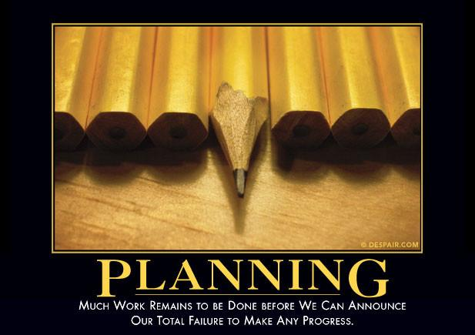
Planning for Success
How to succeed at something we never plan to finish
Collection Structure
Deployment Collections
Maintenance Window Collections
Automatic Deployment Rules
How many do we need
How do we run and maintain them
Software Update Content
Managing the content volume
Reporting on True Success
Notes:
So, how do we successfully do something that wever really plan to finish? And I say it this way because that’s the real hidden truth of patching. There is no “Finish” line in site for it. It will always be an ongoing moving target project/workflow. In fact it’s probably the most dynamic long running “upgrade” your organization will have and we’ve all just forgotten about it. So how do we “close the loop” and how do we plan make it so that the very limited number of resources we have can account for all of this?
Well as everything in Configuration Manager does we start with collections. We need to create structured collections that are going to have meaningful names and types.
We need to create Automatic Deployment Rules, and we need to decide on how many of them we need - and for those of you going “please tell use that – don’t worry we get to that later. Finally how in the world do we run and maintain them?
What about Software Update Content – How do we account for the massive size of content?
And last but not least how do we prove that we don’t suck? That we actually did our job.

Slide 7
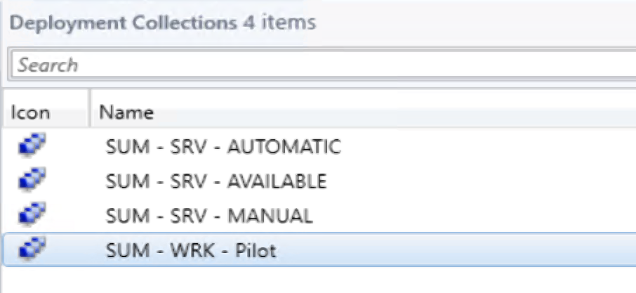
Collection Structure
Decide on a naming structure
Use Keys or Tags
Notes:
I think Collection structure is probably one of the easiest parts of this puzzle to solve, if you are willing to embrace true naming standards in configuration manager. The way I typically create them is I create a master key for all of the collections related to software updates.
“SUM”
“MAINT”

Slide 8
Maintenance Structure
Make a Decision on Maintenance Window Collections
Decide on what type of maintenance windows you are going to use
Know and decide if you are going to change the Client Setting introduced in 1806
This client setting alters the behavior of maintenance windows of “All Deployment Types”
Decide if you are going to be an offset organization or a recurring window organization

Slide 9
Recurring Maintenance Windows
Pros
Cons
Makes scheduling easier
Set it and forget it
Multiple changes to patch servers/workstations with recurring schedules
Can’t account for holidays
Because of the Gregorian calendar “Third Wednesday” moves.
Difficult to stop or cancel for just one month

Slide 10
Offset Maintenance Windows
Pros
Cons
Allows more consistent patch timing
Follows our goal of patch compliance X Days from Patch Tuesday
Allows us to disable patching for 1 month.
Requires at least yearly maintenance.
Requires stake holders to think in the offset mentality.
If you miss the window no refunds.

Slide 11
Collections and Maintenance Window Demo Time

Slide 12
Creating Automatic Deployment Rules Demo Time

Slide 13
Common Questions
Automatic Deployment Rules
How many do you really need
Timing of Automatic Deployment Rules
Creating the “Right Rules”
Deployment Settings are your friend
The “New” vs. “Re-Use” argument

Slide 14
WSUS Clean Up Demo Time

Slide 15
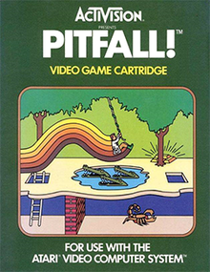
Avoiding Pitfalls
Avoiding Pitfalls
WSUS Maintenance
The smaller your resource pool the more aggressive you need to be.
Maintenance Window Madness
WSUS Synchronization Schedules
On the GLOBAL stage
Reporting the wrong information
Using Required

Slide 16
Avoiding Pitfalls
PATCHING IS REBOOTING

Slide 17
This Sounds like a lot of work… #MEM - #Intune?
PROS
CONS
Easy Update Rings
True Set it and Forget it
No Infrastructure
NO WSUS
Easy Roll Back Options
No real patch exclusion
Semi-Truck – No Brakes
Maintenance Windows?
Server Management?
Windows 7?

Slide 18
Intune Patching Implementation Time

Slide 19
Proving We Did a Good Job
Don’t believe the “Deployment Status” lies
Believe in “Compliant” – Most of the time
Abandon SSRS – it’s too clunky and it’s future in the Cloud management Space is limited
PowerBI – Community Template

Slide 20
PowerBI Implementation Time

Slide 21
Questions?

